Slide 1
Introduction to Java
Notes:
First Class: Introduction, Prerequisites, Advices, Syllabus
Lab 1: Create a Java Project, Compile, and Run.
Show syntax errors
Print program
Capture screen shots, and save it in Word, and print it.
Homework One: Check in the class randomly.

Slide 2
Introduction to Java
What Is Java?
Getting Started With Java Programming
Create,
Compile and
Running a Java Application

Slide 3
What Is Java?
History
Compilation Process of Java
Characteristics of Java

Slide 4
History
James Gosling and Sun Microsystems
Oak
Java, May 20, 1995, Sun World
HotJava
The first Java-enabled Web browser
JDK Evolutions
J2SE, J2ME, and J2EE (not mentioned in the book, but could discuss here optionally)

Slide 5
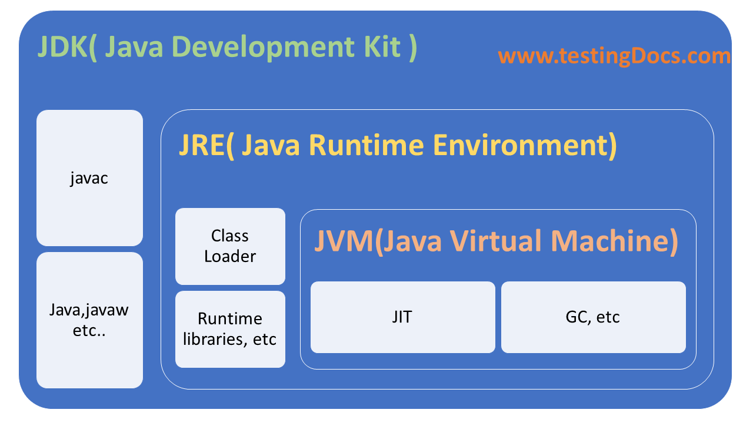

Slide 6
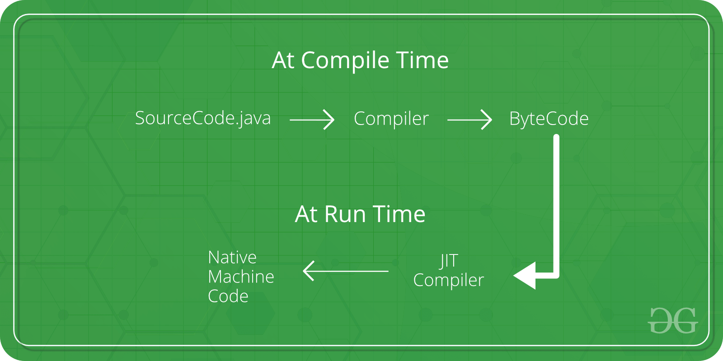

Slide 7
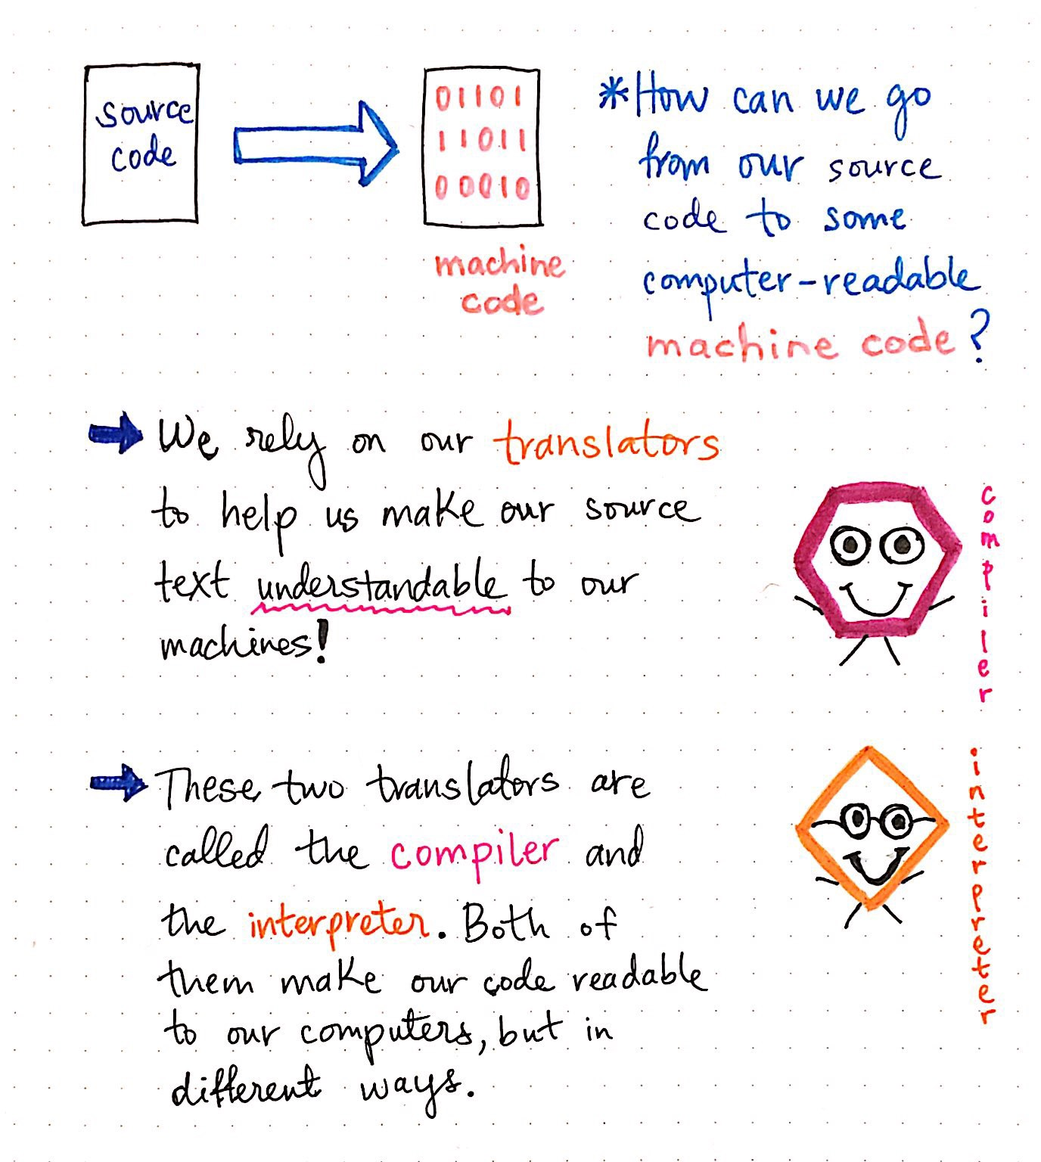

Slide 8
Characteristics of Java
Java is simple
Java is object-oriented
Java is distributed
Java is interpreted
Java is robust
Java is secure
Java is architecture-neutral
Java is portable
Java’s performance
Java is multithreaded
Java is dynamic

Slide 9
JDK Versions

Slide 10
JDK Editions
Java Standard Edition (J2SE)
J2SE can be used to develop client-side standalone applications or applets.
Java Enterprise Edition (J2EE)
J2EE can be used to develop server-side applications such as Java servlets and Java ServerPages.
Java Micro Edition (J2ME).
J2ME can be used to develop applications for mobile devices such as cell phones.

Slide 11
Getting Started with Java Programming
A Simple Java Application
Compiling Programs
Executing Applications

Slide 12
A Simple Application
Example 1.1
//This application program prints Welcome
//to Java!
public class Welcome {
public static void main(String[] args) {
System.out.println("Welcome to Java!");
}
}

Slide 13
Creating and Compiling Programs
On command line
javac file.java

Slide 14
Executing Applications
On command line
java classname

Slide 15
Example
javac Welcome.java
java Welcome
output:...

Slide 16
Anatomy of a Java Program
Comments
Package
Reserved words
Modifiers
Statements
Blocks
Classes
Methods
The main method

Slide 17
Comments
In Java, comments are preceded by two slashes (//) in a line, or enclosed between /* and */ in one or multiple lines. When the compiler sees //, it ignores all text after // in the same line. When it sees /*, it scans for the next */ and ignores any text between /* and */.

Slide 18
Package
The second line in the program (package chapter1;) specifies a package name, chapter1, for the class Welcome. Forte compiles the source code in Welcome.java, generates Welcome.class, and stores Welcome.class in the chapter1 folder.

Slide 19
Reserved Words
Reserved words or keywords are words that have a specific meaning to the compiler and cannot be used for other purposes in the program. For example, when the compiler sees the word class, it understands that the word after class is the name for the class. Other reserved words in Example 1.1 are public, static, and void. Their use will be introduced later in the book.

Slide 20
Modifiers
Java uses certain reserved words called modifiers that specify the properties of the data, methods, and classes and how they can be used. Examples of modifiers are public and static. Other modifiers are private, final, abstract, and protected. A public datum, method, or class can be accessed by other programs. A private datum or method cannot be accessed by other programs. Modifiers are discussed in Chapter 6, "Objects and Classes."

Slide 21
Statements
A statement represents an action or a sequence of actions. The statement System.out.println("Welcome to Java!") in the program in Example 1.1 is a statement to display the greeting "Welcome to Java!" Every statement in Java ends with a semicolon (;).

Slide 22
Blocks
A pair of braces in a program forms a block that groups components of a program.

Slide 23
Classes
The class is the essential Java construct. A class is a template or blueprint for objects. To program in Java, you must understand classes and be able to write and use them. The mystery of the class will continue to be unveiled throughout this book. For now, though, understand that a program is defined by using one or more classes.

Slide 24
Methods
What is System.out.println? It is a method: a collection of statements that performs a sequence of operations to display a message on the console. It can be used even without fully understanding the details of how it works. It is used by invoking a statement with a string argument. The string argument is enclosed within parentheses. In this case, the argument is "Welcome to Java!" You can call the same println method with a different argument to print a different message.

